Slide 1
Measuring performance
Kosarev Nikolay
MIPT
Feb, 2010

Slide 2
Agenda
Performance measures
Benchmarks
Summarizing results

Slide 3
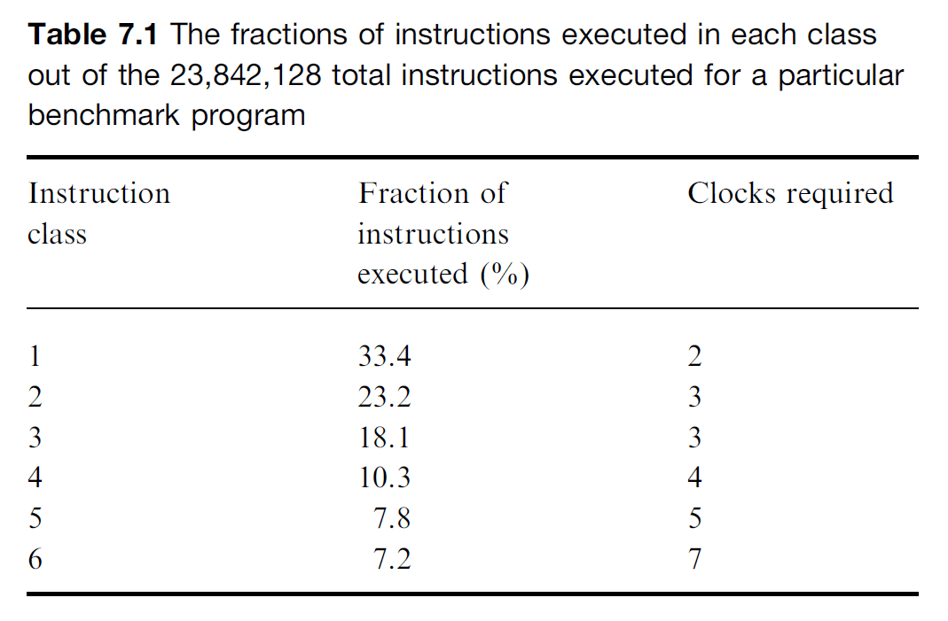
Performance measures
Time to perform an individual operation
The first metric. Used if most instructions take the same execution time.
Instruction mix
Idea is to categorize all instructions into classes by cycles required to execute an instruction. Average instruction execution time is calculated (IPC if measured in cycles).
Gibson instruction mix [1970]. Proposed weights for a set of predefined instruction classes (based on programs running on IBM 704 and 650)
Depends on the program executed, instruction set. Could be optimized by compiler. Ignores major performance impacts (memory hierarchy etc.)

Slide 4
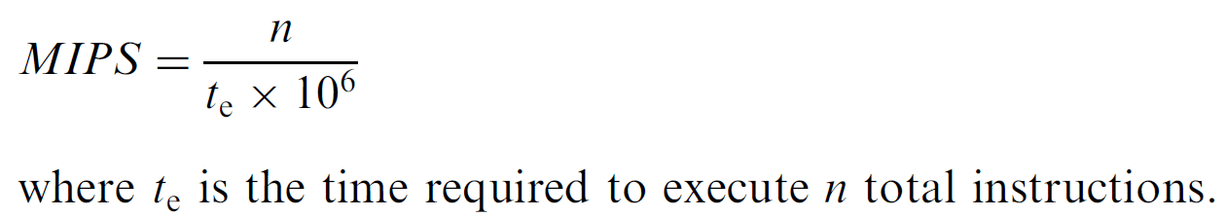

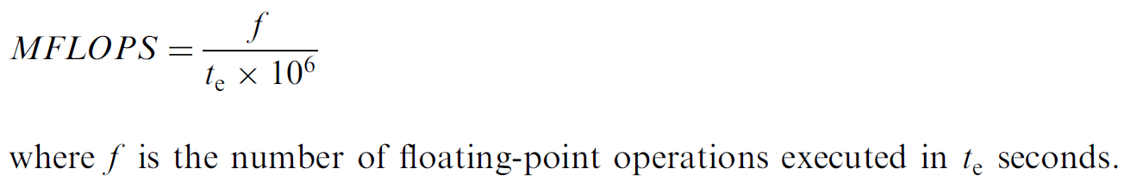
Performance measures (cont.)
MIPS (millions of instructions per second)
Depends on instruction set (the heart of the differences between RISC and CISC).
Relative MIPS. DEC VAX-11/780 (1 MIPS computer, reference machine). Relative MIPS of machine M for predefined benchmark:
MFLOPS (millions of floating-point operations per second)
Metric for supercomputers, tries but not corrects the primary MIPS shortcoming

Slide 5
Performance measures (cont.)
Execution time
Ultimate measure of performance for a given application, consistent across systems.
Total execution time (elapsed time). Includes system-overhead effects (I/O operation, memory paging, time-sharing load, etc).
CPU time. Time spent for execution of application only by microprocessor.
Better to report both measures for the end user.

Slide 6
Benchmarks
Program kernels
Small programs extracted from real applications. E.g. Livermore Fortran Kernels (LFK) [1986].
Don’t stress memory hierarchy in a realistic fashion, ignore operating system.
Toy programs
Real applications but too small to characterize programs that are likely to be executed by the users of a system. E.g. quicksort.
Synthetic benchmarks
Artificial programs, try to match profile and behavior of real application. E.g. Whetstone [1976], Dhrystone [1984].
Ignore interactions between instructions (due to new ordering) that lead to pipeline stalls, change of memory locality.

Slide 7
Benchmarks (cont.)
SPEC
SPEC (Standard Performance Evaluation Corporation)
Benchmark suites consist of real programs modified to be portable and to minimize the effect of I/O activities on performance
5 SPEC generations: SPEC89, SPEC92, SPEC95, SPEC2000 and SPEC2006 (used to measure desktop and server CPU performance)
Benchmarks organized in two suites: CINT and CFP
2 derived metrics: SPECratio and SPECrate
SPECSFS, SPECWeb (file server and web server benchmarks) measure performance of I/O activities (from disk or network traffic) as well as the CPU

Slide 8
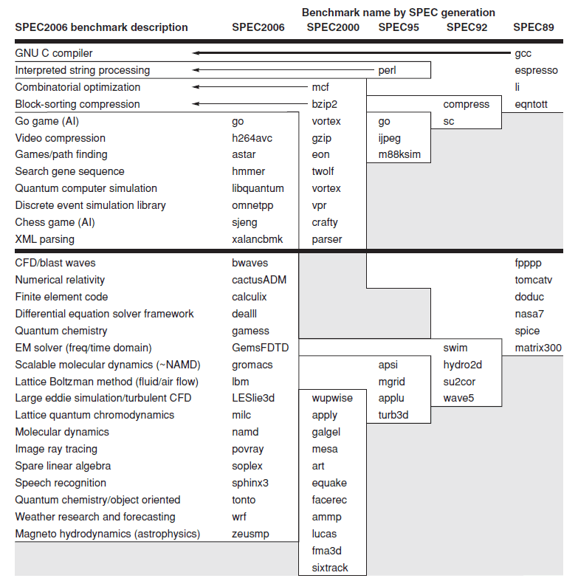
Benchmarks (cont.)

Slide 9

Benchmarks (cont.)
SPECratio is a speed metric
How fast a computer can complete single task
Execution time normalized to a reference computer. Formula:
It measures how many times faster than a reference machine one system can perform a task
Reference machine used for SPEC CPU2000/SPEC CPU2006 is Sun UltraSPARC II system at 296MHz
Choice of the reference computer is irrelevant in performance comparisons.

Slide 10
Benchmarks (cont.)
SPECrate is a throughput metric
Measures how many tasks the system completes within an arbitrary time interval
Measured elapsed time from when all copies of one benchmark are launched simultaneously until the last copy finishes
Each benchmark measured independently
User is free to choose # of benchmark copies to run in order to maximize performance
Formula
Reference factor – normalization factor; benchmark duration is normalized to standard job length (benchmark with the longest SPEC reference time). Unit time – used to convert to unit of time more appropriate for work (e.g. week)

Slide 11


